Slide 1

News Headline Sentiment Analysis
NLP- Sentiment Analysis
- Sunny Mhatre

Slide 2

Introduction
The ability to understand the sentiments behind news headlines has become a crucial aspect of navigating the complex aspects of current affairs.
In this era of instant connectivity, news headlines serve as our first point of contact with the events shaping our world.

Slide 3
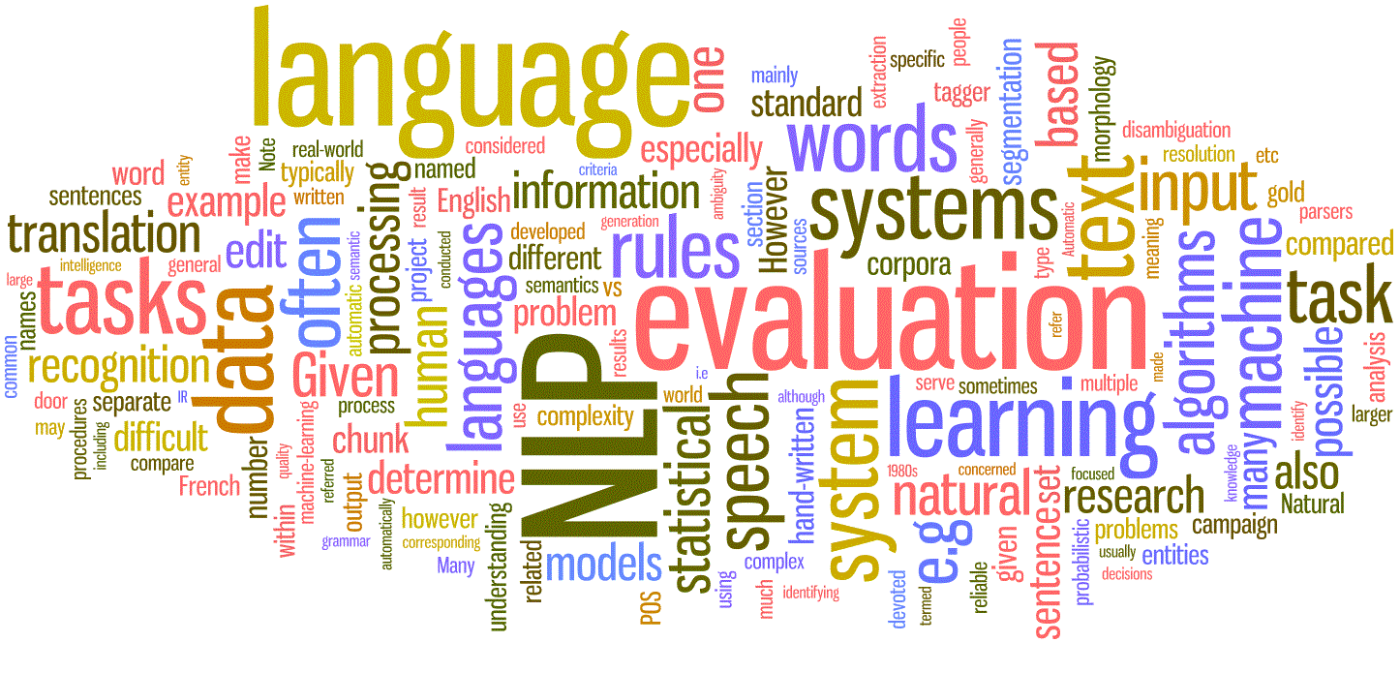
What is NLP?
Natural Language Processing (NLP) is a field of Artificial Intelligences (AI) and Computer Science, that interact between computer and humans in natural language.
The goal of NLP is to develop algorithm and models that enable computers to understand, interpret, generate & manipulate human language.

Slide 4

Objective
To make a powerful tool that allows us to uncover the emotions, opinions, and attitudes embedded in news headlines.
By advanced technologies and data-driven methodologies, we aim to decode the underlying sentiments that influence our perception of the news.

Slide 5
Process Flow
Problem Statement
Fetching Data
Data Pre-Processing & Data Visualization
NLP
Model Building
Business
Conclusion on Model
Checking Accuracy & Model Deploymt
Applying Algorithms

Slide 6





Tools and Platform
Tools : Python
Platform : Jupiter Notebook
Library Used : Sklearn, Pandas, NumPy, Pickle, Matplotlib, NLTK.

Slide 7
About Dataset
Inshorts: Fetch data from Inshorts News.
https://inshorts.com/en/read
Dataset: Using API, I was able to fetch almost 735 News Headlines with there short news from the main menu section of the page. This data contained various languages such as Hindi, English, Hinglish. Saved the data in csv file.

Slide 8
Challenges
Fetching Data: Fetching the Data from site and converting it into Dataset.
Model Evaluation: Selecting the most suitable machine learning model posed a challenge. Iterative testing and evaluation were necessary to find the model with optimal accuracy. As target variable was absent, we need to assign the sentiments as target variable as to build a model.
Overfitting: Some machine learning models, like Random Forest, exhibited overfitting, necessitating further refinement to improve generalization.

Slide 9
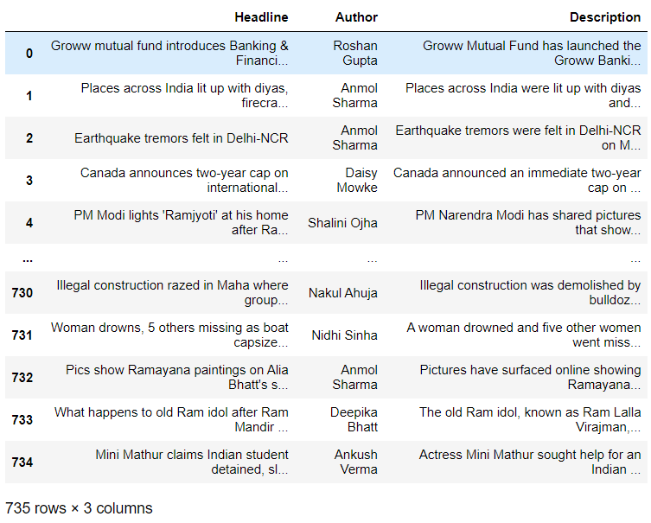
Data Insights
Using API key, I fetched almost 735 News Headlines with a short description on news that were present on the website.
API helps tools that allows different software applications to communicate with each other.
In the dataset, we have Hindi, English, hinglish, punctuations, emojis.

Slide 10
Data Preprocessing
We clean the data before we use to create model for prediction. Below are the step use for Data Cleaning/Preprocessing.
Text Lowercase.
Remove Number.
Remove Punctuation.
Remove URL.
Remove default Stop words.
Remove extra whitespace.
Normalization of Data - Lemmatization

Slide 11
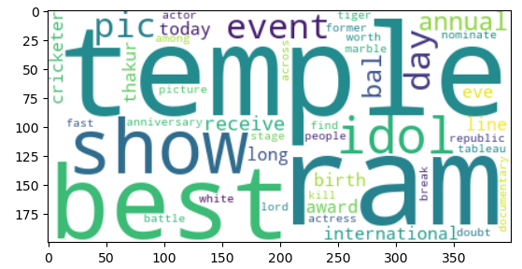
Word Cloud

Slide 12
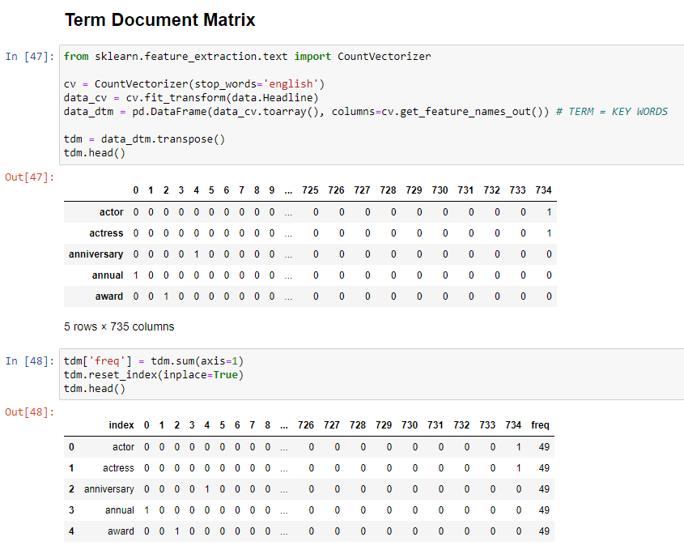
TDM (Term Document Matrix)

Slide 13
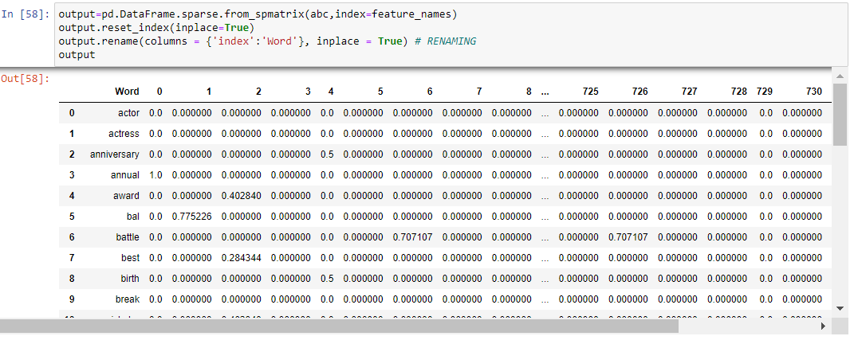
TIF-IDF

Slide 14
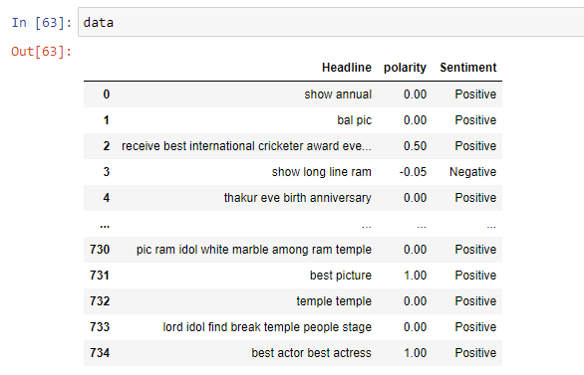
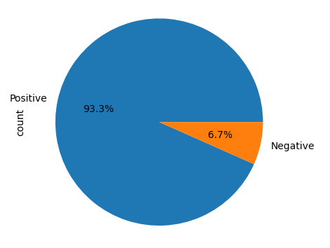
Clean Data

Slide 15


Data Partition
X_Train
Train (70 %)
Dataset
X_Test
Test (30 %)
Y_Train
Y_Test

Slide 16

Models
Decision Tree.
Random Forest
Gradient Boosting
Navie Bayes

Slide 17
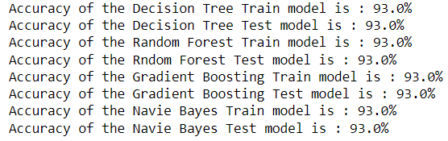
Comparison Between Models

Slide 18
Conclusion & Suggestion
They are more interpretable, and you can analyze the importance of specific words in determining sentiment.
They are not limited to sentiment analysis. They can be adapted for various text-based tasks, such as topic modeling or document clustering.
We can understand various News Headlines related to various background such as, Finances, Stock, Gold, E-Commerce, Product, Market Research.

Slide 19


